Slide 1
Trends in AI/ML: Data Scarcity

Slide 2

Agenda
Intros
Who am I?
What do I do?
Background
What’s driving innovation in AI?
China
Why is China leading the world in AI?
Data Scarcity
Approaches to sharing secure data
Secure Multiparty Computation
Use cases, examples
Some startups
Considerations

Slide 3
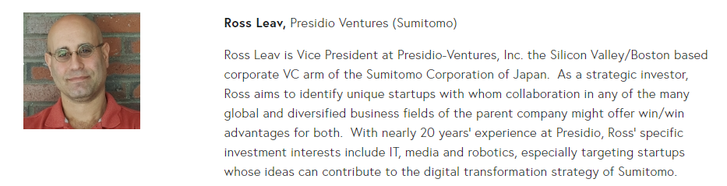
Who am I?
This guy

Slide 4
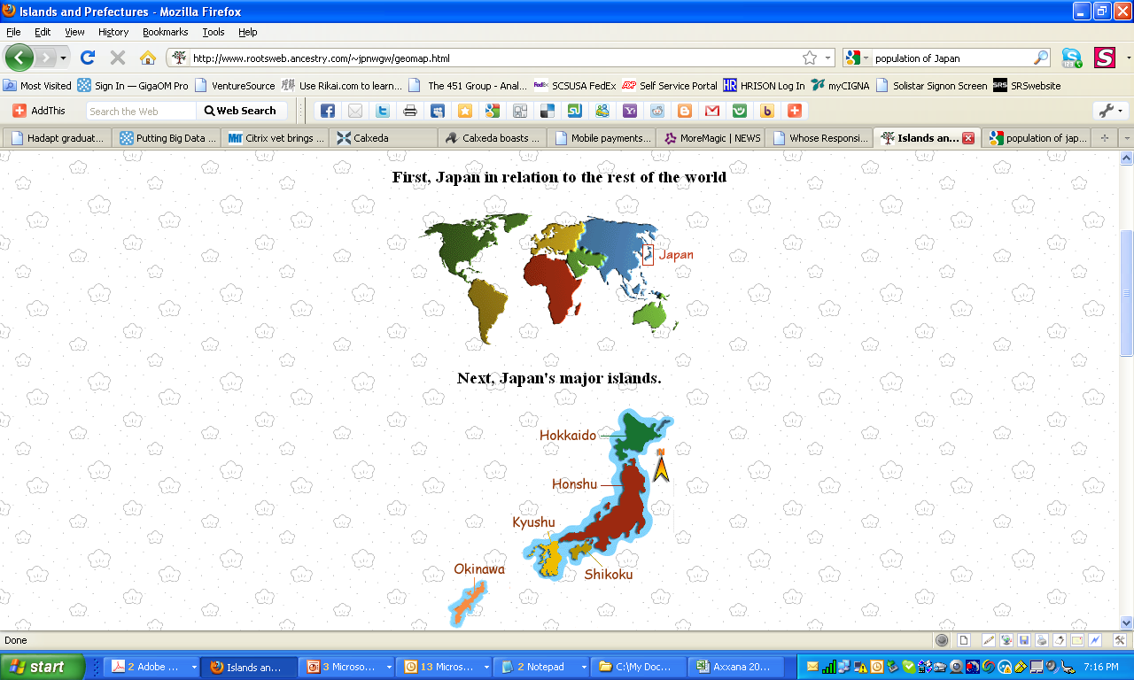
Who am I?
A long time ago, I used to live here.

Slide 5



Who am I?
I now work for the Sumitomo Corporation of Japan

Slide 6
Who am I?
My Company is nearly 400 years old

Slide 7
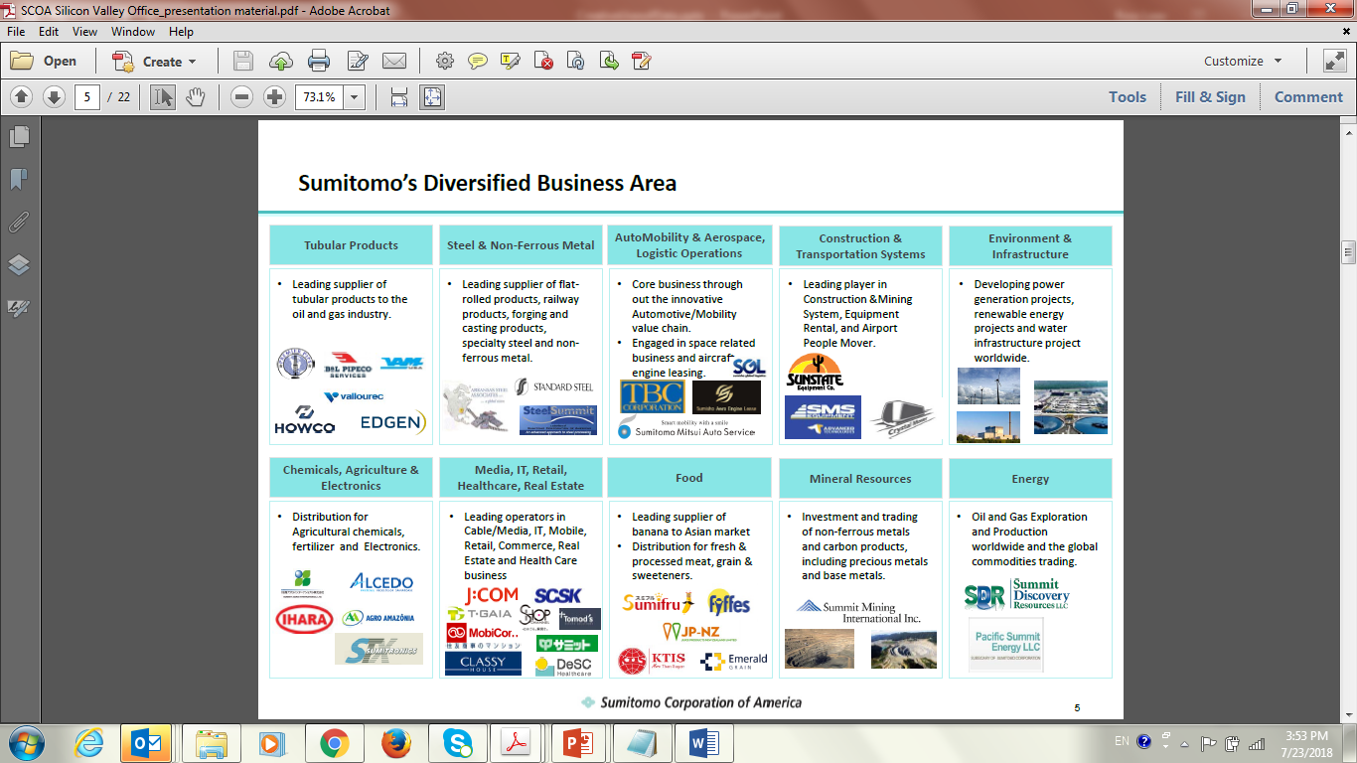
Who am I?
We do a lot of stuff…

Slide 8
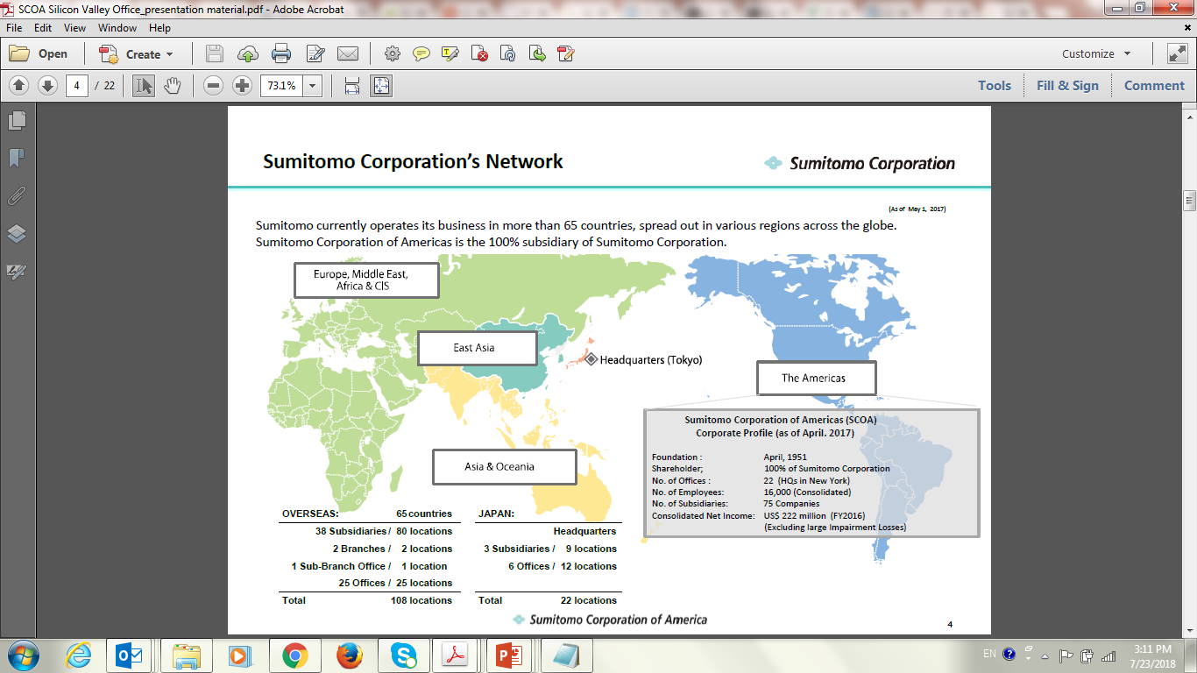
Who am I?
…in a lot of places.

Slide 9






Who am I?
Thank you for your Business

Slide 10
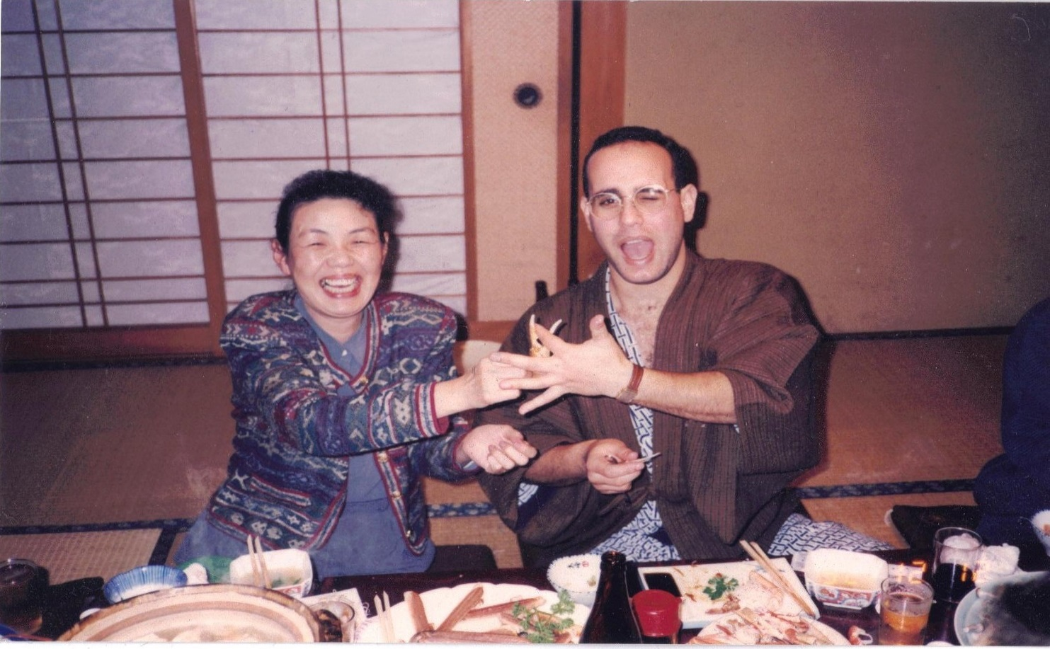
Who am I?
Passionate about International Relations
Glasses were a little different then…
…otherwise I think I pretty much look the same.

Slide 11
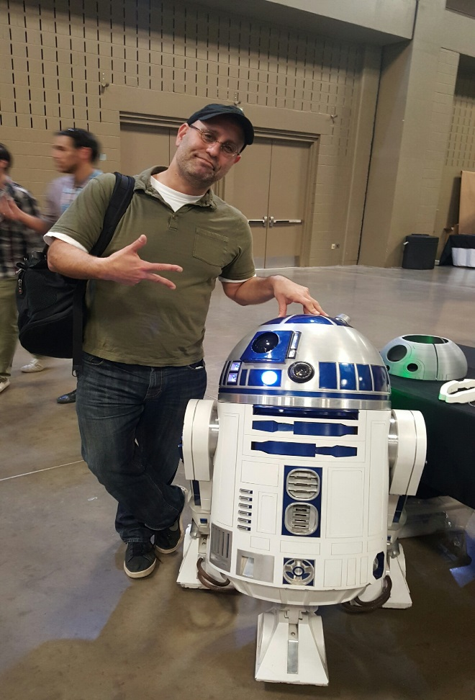
Who am I?
Passionate about Technology
Notes:
The Last Jedi began the slide….
Too much content, too inconsistent…I’m pretty much sick of it all now.

Slide 12
What do I do?
Confessions of a CVC

Slide 13








What do I do?
I’m a Venture Capital-ist
Venture Capital-ism
like any-ism, is about
Belief

Slide 14
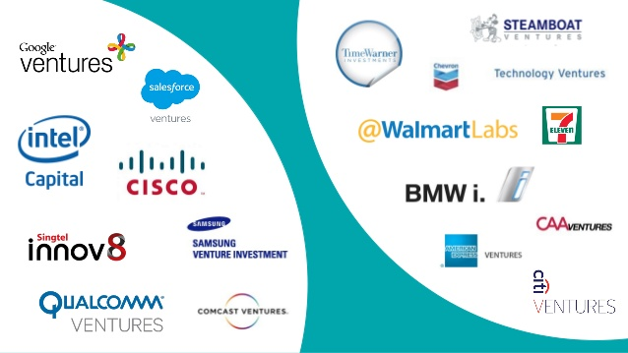
What do I do?
But I’m a Corporate VC
…so I tend to temper belief with pragmat-ISM

Slide 15
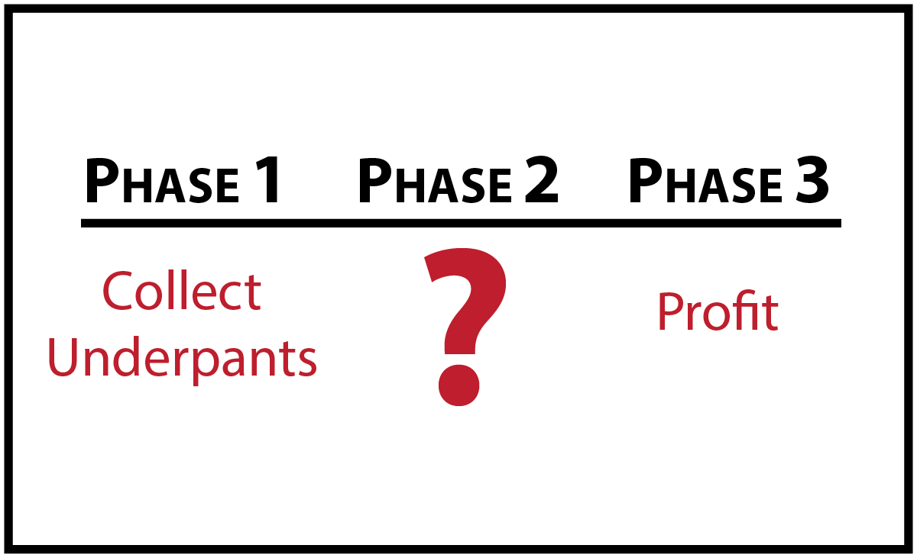
What do I do?
Risk
…I’m skilled at evaluating business ideas

Slide 16
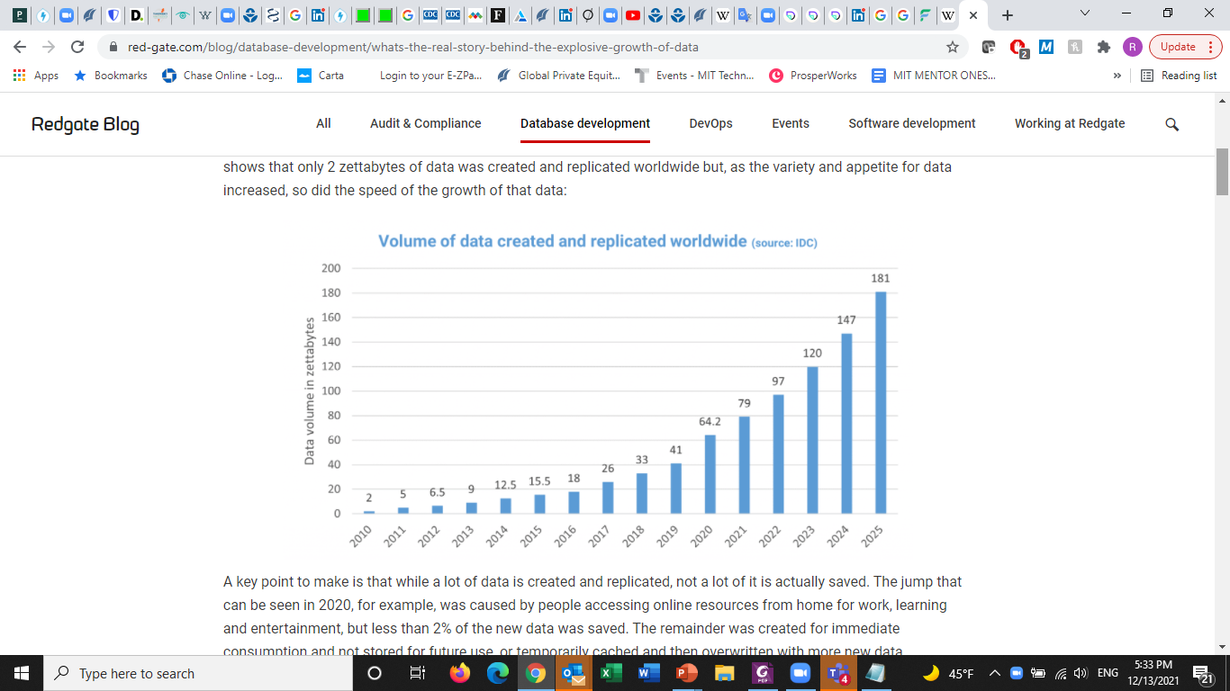
Let’s Talk About Data
Notes:
About 10x every year

Slide 17
Main Drivers
Internet of course: More users, with more bandwidth.
Cheap IoT devices: acoustic, optical, motion, location sensors; Internet connected everything generating M2M data.
Explicit data creation: Users (EG: consumers input to e-commerce, dating, streaming services; enterprises input to CRM, ERP, HRMS).
Implicit data creation: AI makes implicit conclusions about explicit data and online behaviors to generate data about the data (metadata).
Expanding storage and compute: power (especially leveraging cloud)
Mobility: devices generate data about users constantly. Mobile devices become powerful and more useful than fixed ones as mobile network capacity expands dramatically.

Slide 18
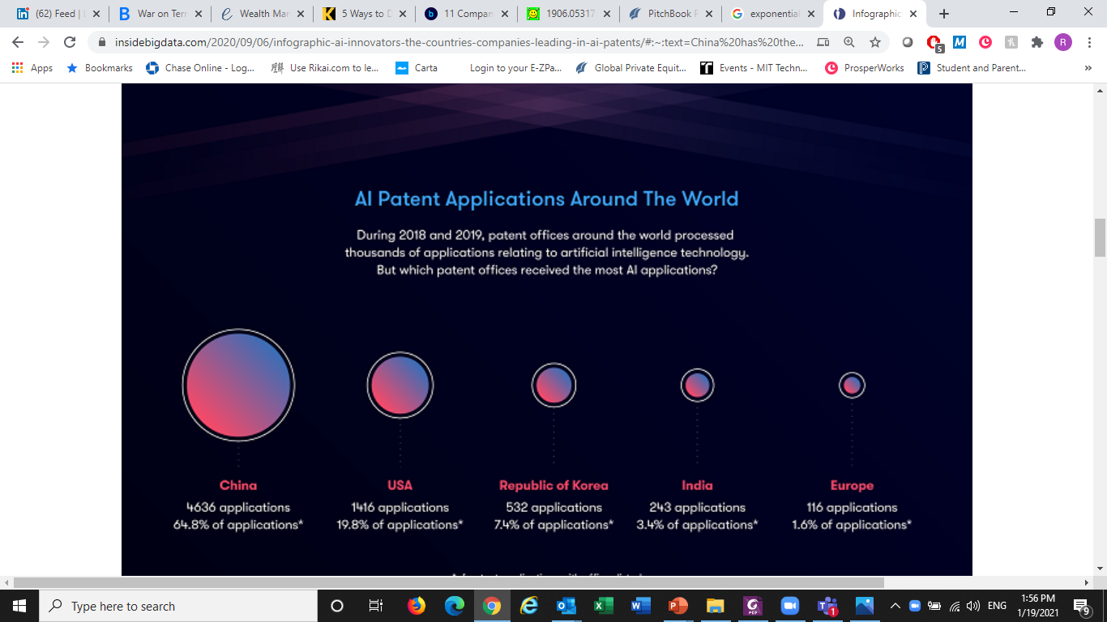
Let’s Look at China
Way ahead in AI...Why?
Jan 2018 to Jan 2020
World class research institutions
Huge pool of highly educated human talent
But also: some restrictions don’t apply….?
insidebigdata.com/2020/09/06/

Slide 19

Think About Training Data… One Example:
In China, roughly 500M users of
Mobile Payments
-Data from mobile device:
-precise location (GPS, WiFi, Cellular)
-movement (speed, acceleration)
-social networking behavior
-application usage
-health/activity
-data from mobile wallet:
-credit usage
-payment history
-consumption habits
-real estate status
-health care consumption
Wow…what could I do with all that training data?
Notes:
(CNNIC). In china, the mobile device is the center of life, including all types of consumer transactions (mobile wallet). Mobile devices now outnumber people in China and Internet access by mobile has reached about 95% of the nearly 800M Internet users there. About 65% of mobile users use their devices for making purchases, large and small. (That’s about 500M people using their mobile devices for making payments). Most of this has happened in the last 3-5 years.. (CNNIC).

Slide 20
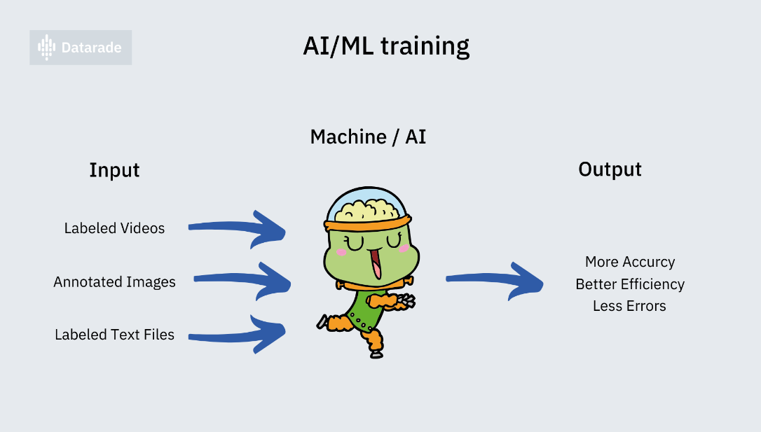
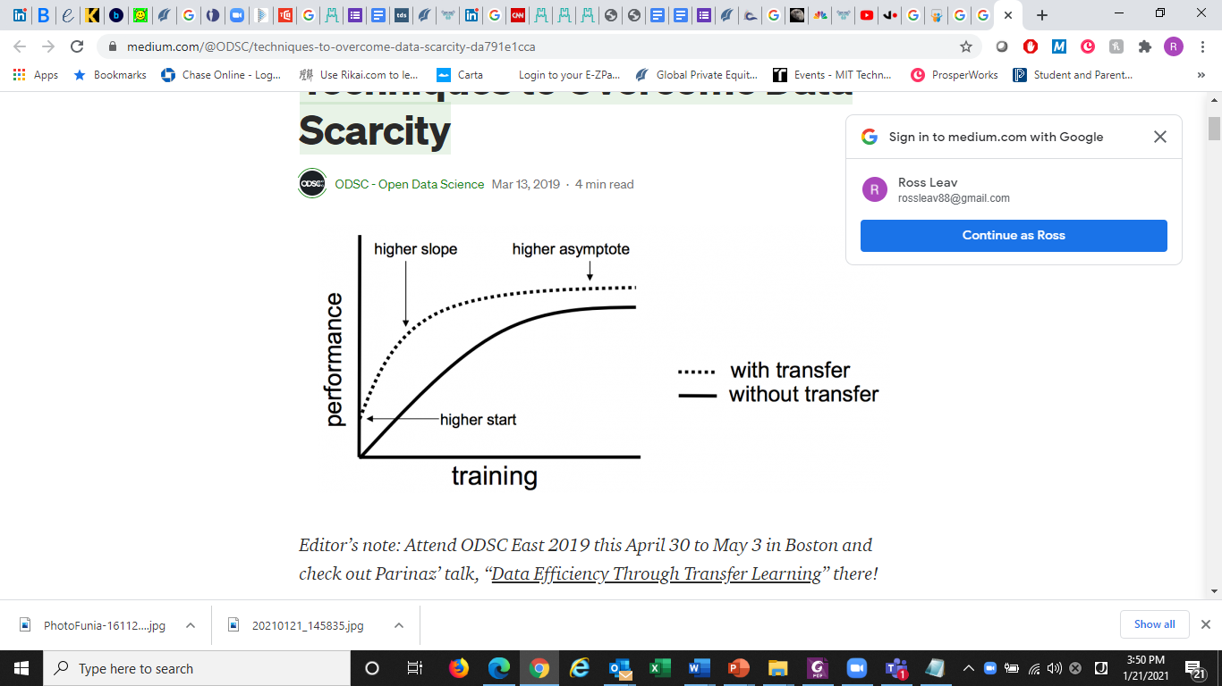
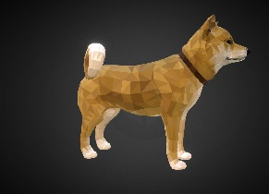
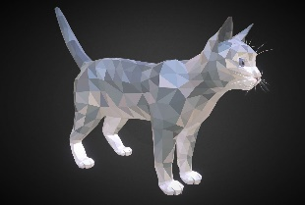
Problem: Scarcity of Training Data
AI/ML needs lots of quality and relevant training data before it can make accurate decisions…
…but it’s hard to find. Restrictions, regulations…
So, innovation is required:
Transfer Learning
Mathematical Optimization
Synthetic Data Injection
Crowd sourcing data
Secure Data Sharing
Transfer Learning

Slide 21
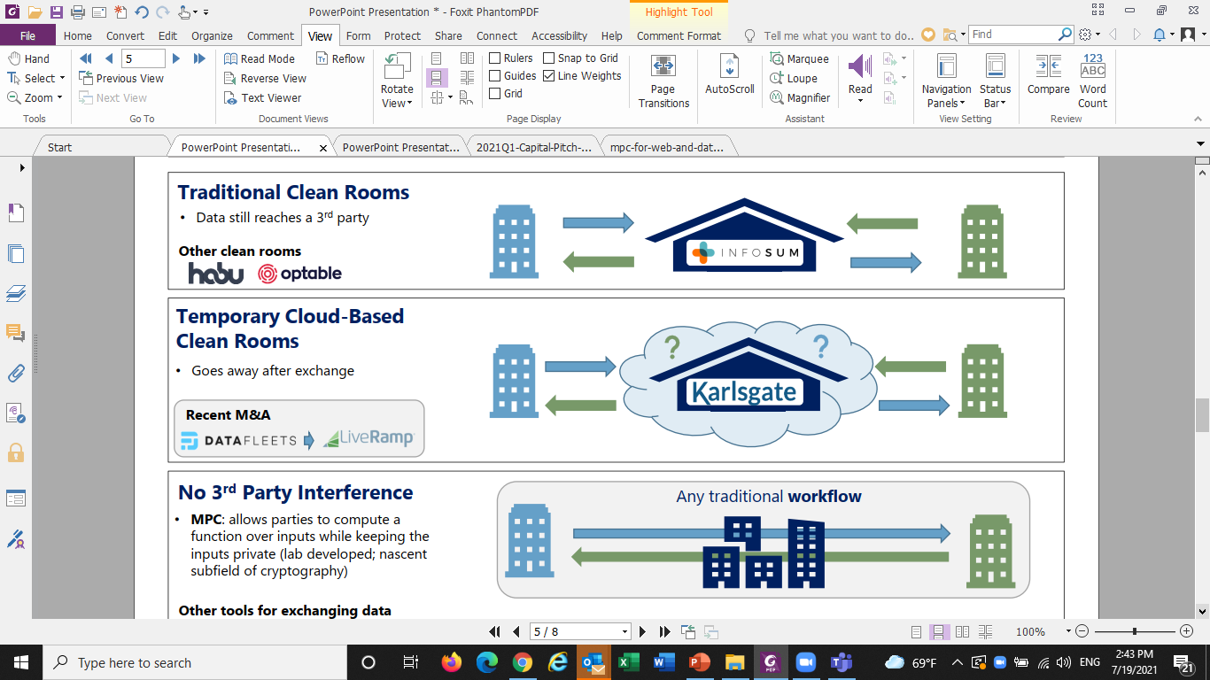
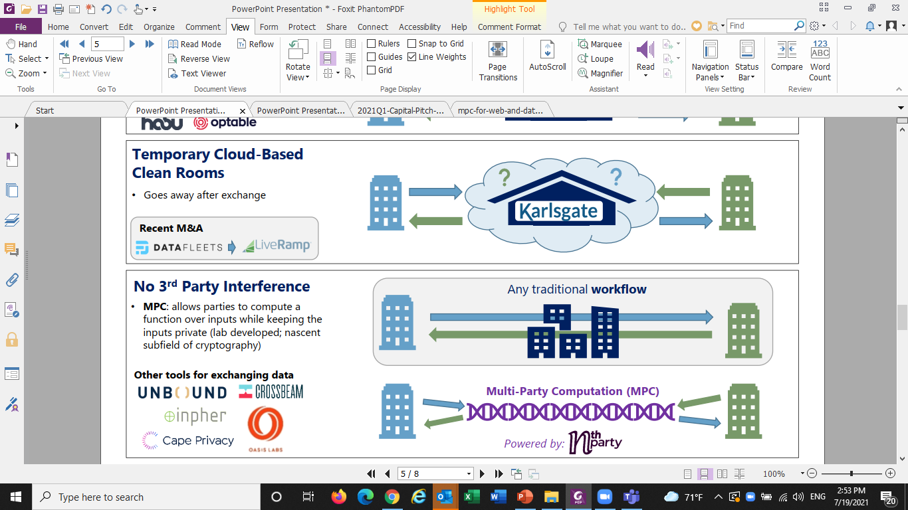

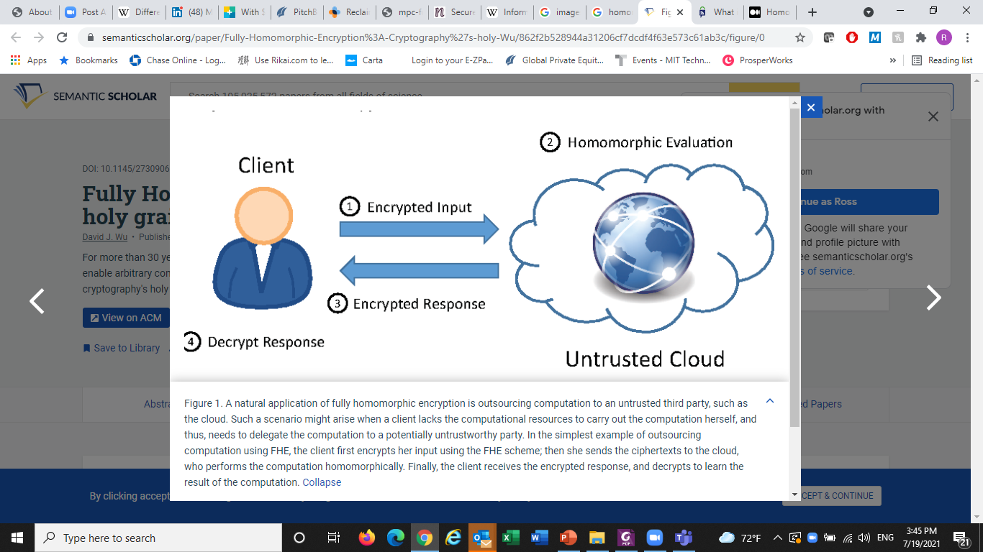
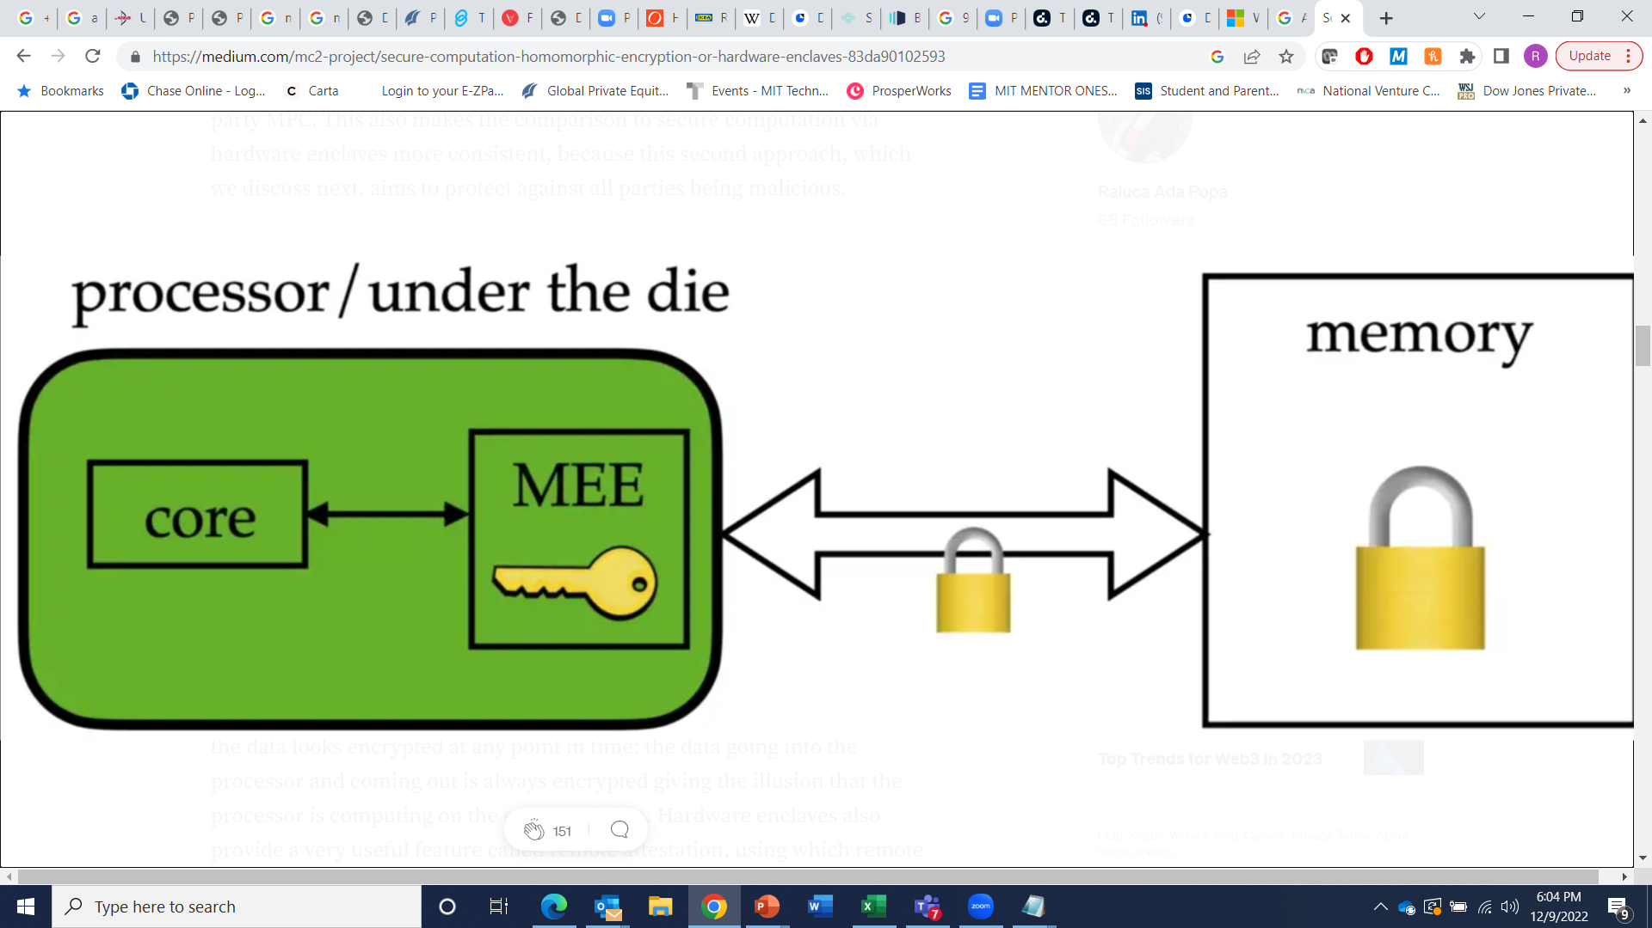
One Solution: Secure Data Sharing
Clean Room:
3rd party virtualizes and encrypts data, provides computation platform
Brokers ongoing access by encryption keys
Temporary Clean Room:
3rd party virtualizes and encrypts data, provides computation platform
Brokers access to platform by keys, then deletes data.
No 3rd Party Required
MPC:
No third party
Sensitive data is distributed randomly amongst peers as Shared Secret
Information Theoretic Security, not subject to computational cracking
Augmenting techniques:
Differential Privacy
Homomorphic encryption
Hardware Enclaves
Differential Privacy
Homomorphic Encryption
Hardware Enclaves
Notes:
DP: Intentional Noise
HE: Data encrypted, structure/patterns extracted for computation and annotation.

Slide 22
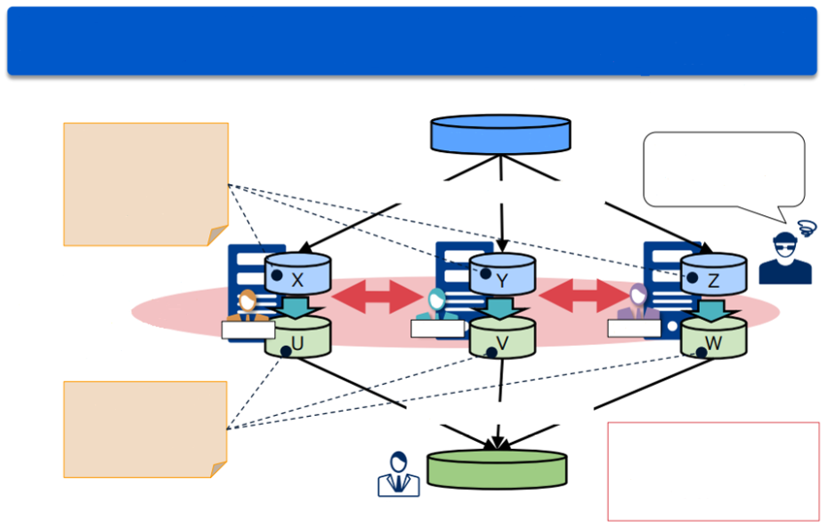
Secure Multiparty Computation
Multi-party computation allows multiple servers to store confidential data in a distributed manner and perform calculation in a confidential manner
Secretly distributed confidential data A
(A=X+Y+Z)
Confidential data A
Hacking a single server will provide only partial data
1. Keep confidential data distributed
2. Calculate distributed data among servers without knowing the original data A
Operator A
Operator B
Operator C
The calculation
result R (R=U+V+W)
3. Restore the calculation result
Improve cyber security by preventing data loss due to cyber attacks
Calculation result R

Slide 23
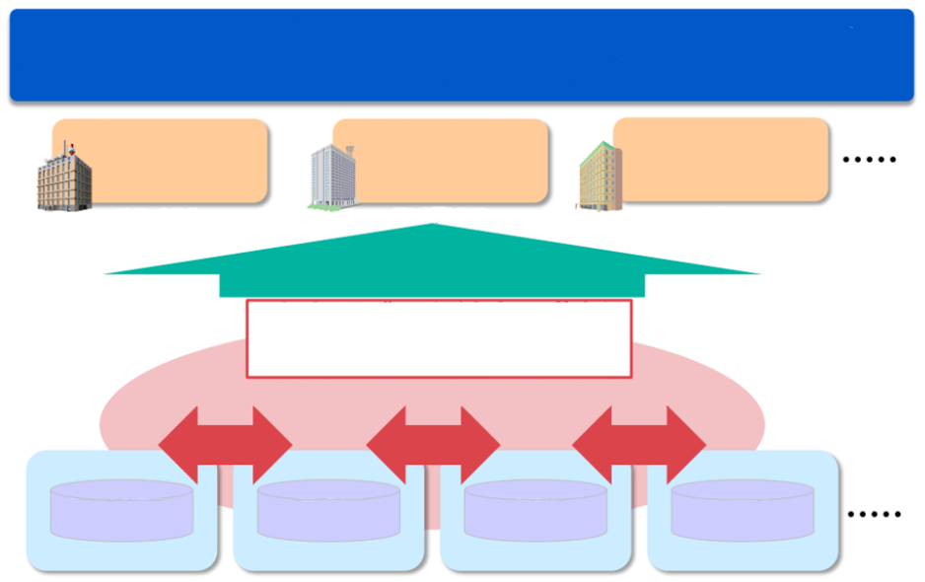
Use Cases
Combine and analyze a variety of confidential data held by organizations without disclosing it to each other, and promote value creation through data utilization across organizations
Disease prevention by analyzing the correlation between disease and exercise
Personalized treatment by correlation analysis of genome and medication
Fraud detection through combined analysis of financial information
Government
Medical research
Financial
Combine data from multiple organizations and provide only the analysis results
Secure data integration and analysis
Combine sensitive data from multiple organizations without disclosing them to each other
Medication/Disease history, genomic information
Exercise, location information
Bank balance, remittance information
Purchase, location information
Medical research
Healthcare company
Financial
EC company

Slide 24
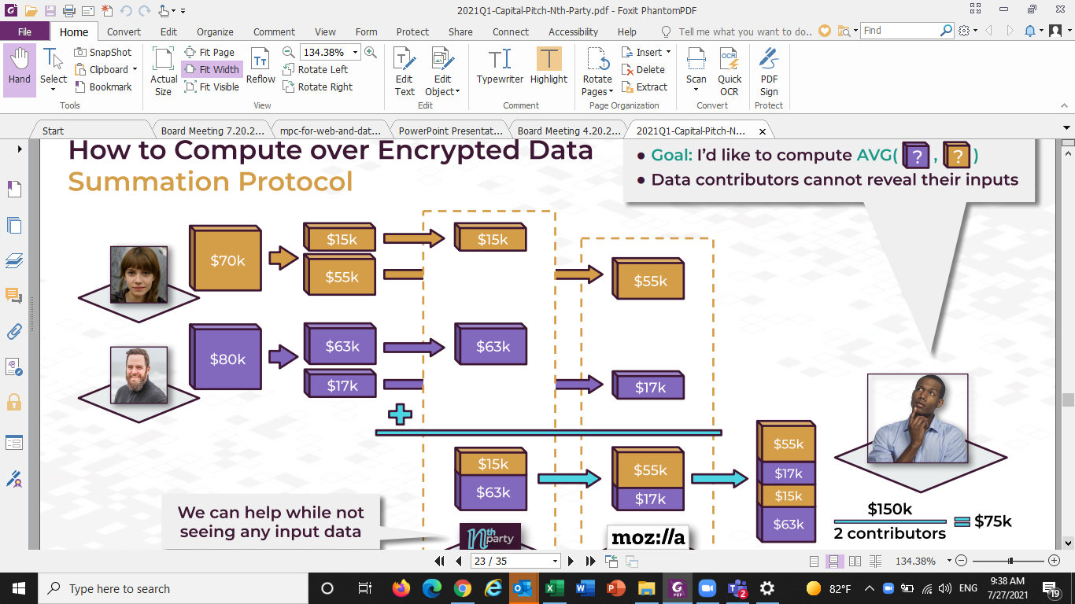


Let me give you an example
How to calculate avg salary at RossCo, Inc. without compromising private info of Alice or Bob?
Alice
Bob
Industry Analyst
Server A
Server B

Slide 25
SMPC Companies of interest:
Company | Technology | HQ | Sector Focus | Founded | Investors
SAIL | MPC using secure enclave CPU hardware users’ algos compute on encrypted data at owner’s side, extract only results | Cambridge, MA | Healthcare – expanding to others | 2017 | E14 Fund
Nth Party | MPC plus Differential Privacy | Boston, MA | Advertising – expanding to others | 2019 | Progress Ventures, Betaworks Ventures, Glasswing Ventures
Enveil | Homomorphic encryption | Fulton, MD | Government | 2016 | In-Q-Tel, Capital One Ventures, Bloomberg Beta, MasterCard
Inpher | MPC plus Homomorphic encryption | New York, NY | Finance | 2015 | Amazon Alexa Fund, JPMorgan Chase, Bowery Capital, Crosslink Capital
Karlsgate | Clean room which uses proprietary combination of techniques (DP, one-time hashing, etc.) to enable matching of datasets, obscuring PII | New Jersey | Marketers & Advertisers | 2019 | -
Infosum | Private cloud based clean room ("Bunker"), which leverages DP to protect PII | England | Advertising | 2016 | Upfront Ventures, Mosaic Ventures, LocalGlobe, Akamai, AT&T, Experian, ITV
Opaque | MPC using hardware enclaves, users algos compute on encrypted data at owner’s side, extract only results | San Francisco, CA | Horizontal | 2021 | Intel, Storm Ventures, Race Capital, Walden Catalyst
Notes:
Unbound Security
Secures enterprise cryptographic infrastructure and manages all critical business transactions, information and digital assets
New York, NY

Slide 26
MPC Considerations
Implementation:
No 3rd party gatekeeper to manage private data but requires stake holders to cooperate
No movement of data required but contributors must consent to queries and data sharing scheme in advance
Security/Performance:
MPC performance declines but security and output quality increases with the number of peers.
May require network and/or hardware acceleration countermeasures.
Utility:
As individual records are obfuscated, circumstances surrounding individual outlier data may be difficult to recover.
As individual records are obfuscated, compliance can be an issue for some applications due to data transparency needs

Slide 27
Appendix

Slide 28

Q & A
Any Questions?

